Slide 1
Multicultural Health Awareness & Health Equity for EMS Professionals
Notes:
Welcome to the Multicultural Health Awareness & Health Equity training for EMS professionals. This PowerPoint is a companion resource for the Multicultural Health Awareness & Health Equity curriculum.

Slide 2
Training Frequency:
Training must be completed during all initial EMS education EMR, EMT, AEMT, and Paramedic courses.
Training must be completed once every four years by all credentialed EMS providers.
Notes:
This training must be completed during all initial EMS education EMR, EMT, AEMT, and Paramedic courses. RCW 43.70.615: Multicultural health awareness and education program—Integration into health professions basic education preparation curriculum.
Training must be completed once every four years by all credentialed EMS providers.
RCW 43.70.613: Health care professionals—Health equity continuing education. (wa.gov)
WAC 246-12-800: WAC 246-12-810: WAC 246-12-820: WAC 246-12-830:
Materials: Multicultural Health Awareness & Health Equity curriculum as a companion to this presentation. Additional materials may be added to ensure the cultural needs of the community are met.
Personnel:
Primary instructor knowledgeable in:
Roles and responsibilities of EMS professionals and prehospital EMS care.
Multicultural health disparities.
Demonstrated knowledge and experience related to health equity through lived experience or training.
Length: Minimum Time to Complete: Two hours. Can be separated into multiple modules.
Verification of Competency:
There will be an assessment at the end of an in-person or virtual continuing education training to determine knowledge gained during that training, or document attendance at the training.

Slide 3
Course Objectives:
At the completion of this lesson, the student will be able to:
Evaluate areas of personal knowledge, attitudes, and skills to help improve patient care to diverse populations.
Formulate a plan to serve as a model for others when practicing cultural competency with patients, family, and bystanders.
Develop awareness of one’s own and others’ biases and the implications in the healthcare setting.
Notes:
As we begin this course, please understand that there is a difference between acceptance and agreement. You are not being asked to change your beliefs; you are being invited to respect others.
The intent of this course is to:
Practice attitudes and skills that will help when providing care to diverse populations.
Examine the relationship between culture, language, and health.
Discuss implicit bias and how bias, racism, and poverty manifest as health inequities.
Evaluate strategies to help reduce bias during assessment and treatment.
Recognize how social determinants of health impact individuals, and communities.
Describe best practices of working with an interpreter.
The AFFECTIVE OBJECTIVES are to:
Evaluate areas of personal knowledge, attitudes, and skills to help improve patient care to diverse populations.
Formulate a plan to serve as a model for others when practicing cultural competency with patients, family, and bystanders.
Develop awareness of one’s own and others’ biases and the implications in the healthcare setting.

Slide 4
Introduction:
Here and across the country, health disparities exist:
Health care resources are distributed unevenly, and these inequities have permeated health care delivery, deepening adverse outcomes for marginalized communities.
Many people do not receive health care or if they do, it is not the same quality of health care that other people receive.
Washington State is a model in addressing health disparities.
Notes:
Washington State has a diverse and dynamic population. Here and across the country, health disparities exist.
Research shows that health care resources are distributed unevenly by intersectional categories including, but not limited to, race, gender, ability status, religion, sexual orientation, socioeconomic status, age, and geography; and these inequities have permeated health care delivery, deepening adverse outcomes for marginalized communities.
As health providers, understanding the full landscape and context of people is vital to our role as EMS providers.
Many people do not receive health care or if they do, it is not the same quality of health care that other people receive. These differences are experienced by racial, ethnic, gender and cultural groups, immigrant, and refugee communities and economically and socially disadvantaged populations.
Washington state is a model state in addressing health disparities. Our state is committed to improving health and increasing access to care for all our communities and individuals living within our borders. Additionally, the COVID-19 pandemic has further exposed inequities in health outcomes due to discrimination and bias in the health care system.
Discussion Question- What health disparities exist in your area and how do they impact members of your community?

Slide 5
Introduction:
Providing care for multicultural populations:
By the year 2050, almost half the population will be from cultures other than white or non-Hispanic.
Washington will need to address the needs of its changing population.
We can help meet these health care needs by providing culturally and linguistically appropriate health care and by improving quality and access to care.
Notes:
We are providing care for multicultural populations right now and in the future:
US Census data indicates that by the year 2050, almost half the population will be from cultures other than white or non-Hispanic.
Washington will need to address the needs of its changing population.
We can help meet these health care needs by providing culturally and linguistically appropriate health care and by improving quality and access to care.
Discussion Questions- How culturally diverse is your area? What about people traveling through your area?

Slide 6
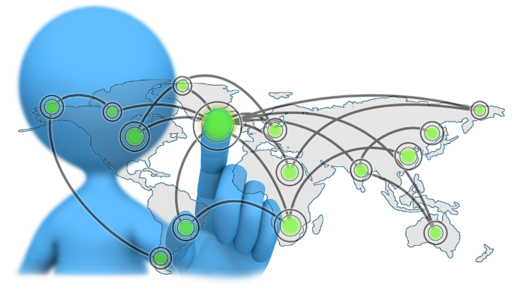
Building a Foundation
Definitions:
Explicit & implicit bias
Race & ethnicity
Sex & gender
Culture - Cultural competence, cultural humility, cultural relativism, acculturation, culture shock, ethnocentrism, and racism
Health - Determinants of health, health disparity, health equity
Socioeconomic considerations – poverty and power
Notes:
An understanding of terminology provides a strong foundation. In the process of reviewing definitions consider the relationship between culture, language, and health.
The following slides will provide detailed definitions of these complex terms.

Slide 7
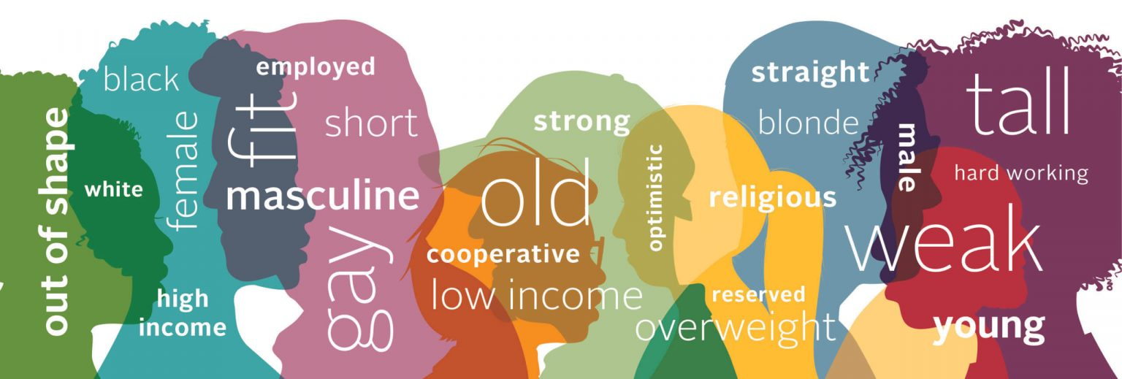
Building a Foundation
Definitions:
What is bias and how does it impact patient care?
Explicit bias
Implicit bias
Notes:
How does bias impact patient care and patient outcomes?
The definition of bias-
Bias: Attitudes, behaviors, and actions that are prejudiced in favor of or against one person or group compared to another.
The definitions of explicit and implicit bias-
Explicit biases: A form of bias that occurs intentionally and affects the attitudes and assumptions that we acknowledge as part of our personal belief systems, can be assessed directly by means of self-report.
Implicit biases: A form of bias that occurs automatically and unintentionally, that nevertheless affects judgments, decisions, and behaviors. Including attitudes and beliefs about race, ethnicity, age, ability, gender, or other characteristics that operate outside our conscious awareness and can be measured only indirectly.

Slide 8
Bias:
What is bias?
Understanding the difference between explicit and implicit bias.
Explore an Implicit Bias test such as: Take a Test (harvard.edu)
Notes:
Now that we know what bias is, how do we recognize it? Understanding the difference between explicit and implicit bias.
Suggestion to compete Implicit Bias test such as Take a Test (harvard.edu) or other, to gain awareness.
Tools to help a person identify implicit bias.
Strengths and limitations of implicit bias tests
Self-assessment examples (this could be pre-course work)
A (2019) study found that Oregon EMTs and paramedics were 40% less likely to give Black patients pain medicine.
It is likely that a contributing factor to this inequality is implicit biases
Seventy percent of EMTs are white.
White people have no genetic proclivity toward racism
People (of all races)struggle to forgive and to trust people who are not in their ingroup
People struggle to read the non-verbal communication of people who are not in their ingroup
This study goes on to state that explicit racism by EMTs is very rare. Link to study- A Thousand Cuts: Racial and Ethnic Disparities in Emergency Medicine - PMC (nih.gov)
“Well-meaning people who consciously reject racism or other bias may unwittingly act in ways that result in discrimination because of implicit bias” (Police Executive Research Forum, 2016). Home (policeforum.org)
Discussion- Relationship between bias, racism, and poverty, and health inequities.
Partial speaker note content courtesy of King County EMS and 828 Flow ESJ Course Content 2023.

Slide 9
Bias:
Common biases during assessment and treatment
Types of unconscious bias in clinical medicine:
Anchoring bias
Availability bias
Confirmation bias
Notes:
Common biases encountered during assessment and treatment:
Types of unconscious bias in clinical medicine-
Anchoring bias- refers to people’s tendency to rely too heavily on the first piece of information they receive on a topic. Regardless of the accuracy of that information, individuals use it as a reference point, or anchor, to make subsequent judgments.
Availability bias- is a type of cognitive bias that helps us make fast, but sometimes incorrect, assessments. It involves relying on information that comes to mind quickly or is most available to us.
Example- When asked if falling airplane parts or shark attacks are a more likely cause of death in the United States, most people would say shark attacks. In reality, the chances of dying from falling airplane parts are 30 times greater than the chances of being killed by a shark.
People overestimate the risk of shark attacks because there are far more news stories and movies about them. As a result, images of shark attacks are easier to bring to mind. If you can quickly think of multiple examples of something happening, then you are tricked into thinking it must happen often.
Confirmation bias- is the tendency to seek out and prefer information that supports our preexisting beliefs. As a result, we tend to ignore any information that contradicts those beliefs.
Confirmation bias is often unintentional but can still lead to poor decision-making.
Discussion Question- Think of a time when unconscious bias may have influenced a decision you made.

Slide 10
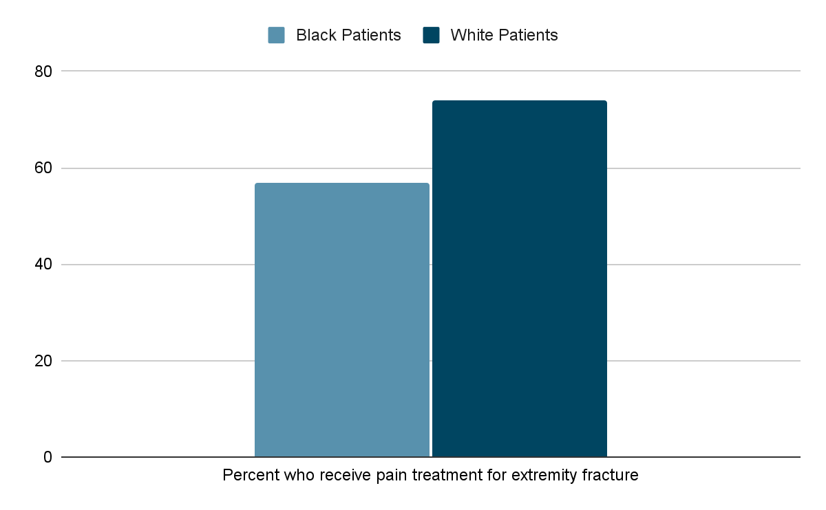
Bias Created Challenges:
Common biases during assessment and treatment
Pain tolerance / Pain medication administration needs
Slide content courtesy of King County EMS and 828 Flow ESJ Course Content 2023
Notes:
Common biases during assessment and treatment
Bias created challenges-
Pain tolerance / Pain medication administration needs
Misdiagnosis
A study of over 104,000 medical charts for ambulance patients found that Oregon EMTs and paramedics were 40% less likely to give Black patients pain medicine. This disparity existed across socioeconomic status (Kennel et al., 2019) Disparities and inequalities in pain treatment among people with limited English proficiency - PMC (nih.gov)
Experimental studies that controlled for self-reported pain and similarity in injury found Black patients were significantly less likely than White patients to receive analgesics for extremity fractures in the emergency room (57% of Black patients vs. 74% of White patients)(Hoffman et al., 2016) Racial bias in pain assessment and treatment recommendations, and false beliefs about biological differences between blacks and whites - PubMed (nih.gov)
“For instance, a study of nearly one million children diagnosed with appendicitis revealed that, relative to white patients, black patients were less likely to receive any pain medication for moderate pain and were less likely to receive opioids—the appropriate treatment—for severe pain (Goyal et al.2015)” Racial Disparities in Pain Management of Children With Appendicitis in Emergency Departments - PubMed (nih.gov)
This suggests that Black people are underrepresented in treatment, and/or that White people are overrepresented.
Slide content courtesy of King County EMS and 828 Flow ESJ Course Content 2023.

Slide 11
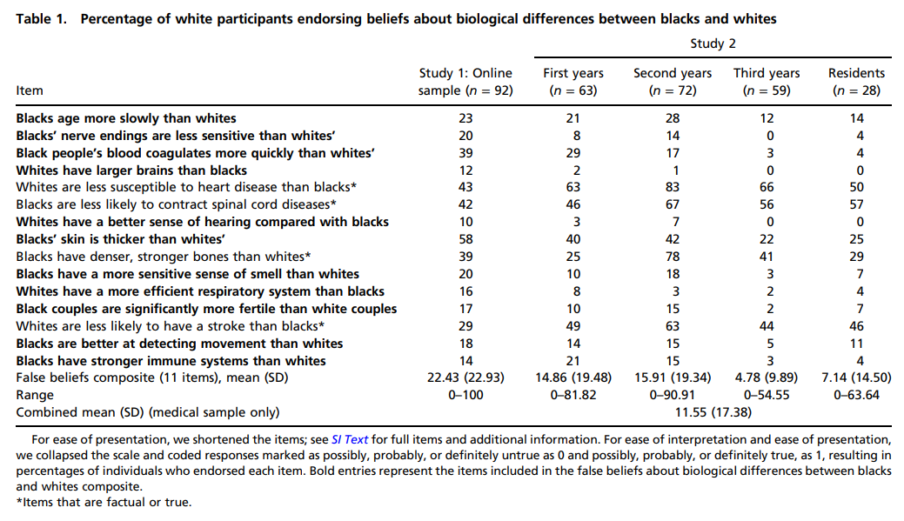
Bias Created Challenges:
Slide content courtesy of King County EMS and 828 Flow ESJ Course Content 2023
Notes:
Black Americans are systematically undertreated for pain relative to white Americans. A 2016 study examined whether this racial bias is related to false beliefs about biological differences between blacks and whites (e.g., "black people's skin is thicker than white people's skin"). Study 1 documented these beliefs among white laypersons and revealed that participants who more strongly endorsed false beliefs about biological differences reported lower pain ratings for a black (vs. white) target. Study 2 extended these findings to the medical context and found that half of a sample of white medical students and residents endorsed these beliefs. Moreover, participants who endorsed these beliefs rated the black (vs. white) patient's pain as lower and made less accurate treatment recommendations. Participants who did not endorse these beliefs rated the black (vs. white) patient's pain as higher but showed no bias in treatment recommendations. These findings suggest that individuals with at least some medical training hold and may use false beliefs about biological differences between blacks and whites to inform medical judgments, which may contribute to racial disparities in pain assessment and treatment.
Link to study- Racial bias in pain assessment and treatment recommendations, and false beliefs about biological differences between blacks and whites - PubMed (nih.gov)
Slide content courtesy of King County EMS and 828 Flow ESJ Course Content 2023.

Slide 12
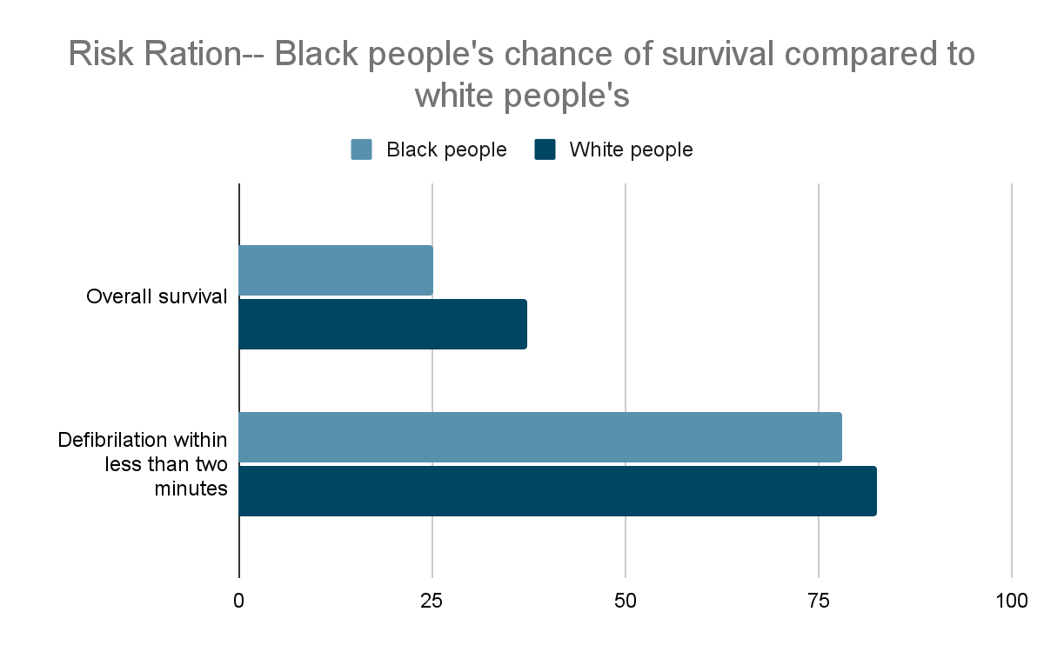
Bias Created Challenges:
Common biases during assessment and treatment
Longer response times- impact cardiac arrest outcomes
Slide content courtesy of King County EMS and 828 Flow ESJ Course Content 2023
Notes:
Common biases during assessment and treatment
Longer Response Times- impact cardiac arrest outcomes
A study found that EMS response times in low-income neighborhoods, which are often communities of color, were longer than in wealthier neighborhoods when responding to a call about cardiac arrest (Hsia et al., 2018) A US National Study of the Association Between Income and Ambulance Response Time in Cardiac Arrest - PubMed (nih.gov)
Once at the hospital, a 2009 study found that Black patients were less likely to survive to discharge after in-hospital cardiac arrest.
Unadjusted–Black patients were over 27 percent less likely to survive than their white peers.
When controlled by patients’ medical characteristics Black people were 20 percent less likely to survive.
When controlled for factors such as hospital facilities and staff training Black people remained 11% less likely to survive (Chan et al., 2019) Resuscitation Practices Associated With Survival After In-Hospital Cardiac Arrest: A Nationwide Survey | Resuscitation | JAMA Cardiology | JAMA Network
The differences in these adjusted rates demonstrates that factors such as response times are the primary factor in the disparity in overall survival rates.
Slide content courtesy of King County EMS and 828 Flow ESJ Course Content 2023.

Slide 13
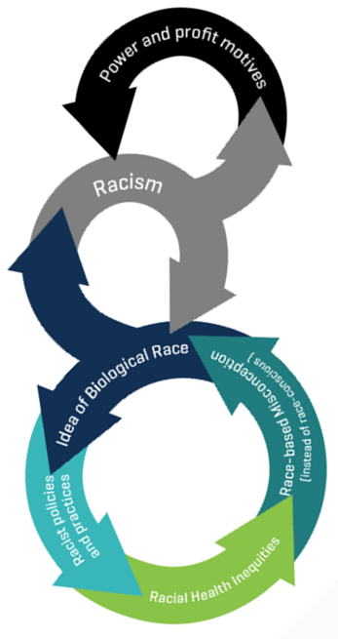
Bias Created Challenges:
Race is not the cause, but it is a factor
“Our current scientific understanding of the biological basis of human genetic variation demonstrates that there are no biological features that are present in all members of one "race" group and not in others. While race is not a genetically meaningful category, it can still impact biology through the enactment of racist policies and practices - which result in inequities in areas such as healthcare.”
-Fred Hutch Cancer Center
Slide content courtesy of King County EMS and 828 Flow ESJ Course Content 2023
Notes:
Bias Created Challenges
Reinforcing the Circle of “Race”
If we assume that people who are racialized
as “Black” or “white” are fundamentally different
and treat them accordingly, the paradoxical
result is that it will produce the very
biological differences we presumed to exist in the first place.
But it’s not because of any deep-seated
differences in our DNA. It’s because our social
structures and attitudes promote the well-being
of some and devalue others.”
Dr. Clarence Gravlee
Associate Professor of Anthropology, University of Florida
Slide content courtesy of King County EMS and 828 Flow ESJ Course Content 2023.

Slide 14
Building a Foundation:
Definitions: Race & Ethnicity
Ethnicity: Cultural factors that influence a person or community such as nationality, culture, ancestry, language, and beliefs.
Race: Socially constructed system of organizing people into groups based on characteristics such as cultural affiliation, physical appearance, language, national heritage, religion, or ancestral geographical base.
Notes:
Race & ethnicity-
Ethnicity: Cultural factors that influence a person or community such as nationality, culture, ancestry, language, and beliefs.
Race: Socially constructed system of organizing people into groups based on characteristics such as cultural affiliation, physical appearance, language, national heritage, religion, or ancestral geographical base.
Race/ethnicity has no genetic basis— no characteristic, trait, or gene distinguishes members of one racial/ethnic group from another. The single term race/ethnicity emphasizes how the words are non-precise and socially constructed.
Discussion Question- What is a social construct? Name other social constructs we encounter daily.
Social Construct: A social construct is any category or thing that is made real by convention or collective agreement. Socially constructed realities are contrasted with natural kinds, which exist independently of human behavior or beliefs. Simple examples of social constructs are the meaning of words and the value of paper money.

Slide 15
Building a Foundation:
Definitions:
Sex/Biological Sex: distinguished as female or male especially on the basis of their reproductive organs and structures.
Gender/Gender identity: the behavioral, cultural, or psychological traits typically associated with one sex or a person's internal sense of being male, female, some combination of male and female, or neither male nor female.
Notes:
What is the difference between biological sex and gender?
Sex/Biological Sex: Either of the two major forms of individuals that occur in many species and that are distinguished respectively as female or male especially on the basis of their reproductive organs and structures.
Gender/Gender identity: the behavioral, cultural, or psychological traits typically associated with one sex or a person's internal sense of being male, female, some combination of male and female, or neither male nor female.
Social and gender identity potential barriers to care
Communication- ask questions, “How would you want to be addressed?”
Having a gender-inclusive language expands our ability to communicate effectively.
Patient centered care and communication improve healthcare outcomes across all patient populations.
How to address barriers:
Addressing barriers needs the cooperation of the patient, the care provider, and the organization or system where the encounter takes place. If a process is in place that includes these three different participants, then the resource for removing or lessening the impact of the barrier is also in place.
Clear communication is the key to appropriate care. A communication approach that takes for granted a shared cultural background, gender orientation, and level of literacy may create instant barriers to care for many underserved communities.
Trust is important. If there is trust, the provider and patient can reach agreement about care.
Just as one size doesn’t fit all, one program or service won’t always work for all groups of a particular population.
Maintain awareness and respect.
Provide culturally appropriate materials and language resources. Materials appropriate for one group of clients may not convey important concepts to another group of clients. Materials provided in English and those translated into a single other language may simply be inadequate in conveying health care information.
Discussion Questions- What are social and gender identity potential barriers to care? How can gender inclusive language expand our ability to communicate effectively?

Slide 16
Bias: Contributing Factors
Racist policies and behaviors help create and reinforce inequities, including health inequities.
Causes are comprehensive, diverse, and systemic.
Knowledge of inequities must be used to help us identify areas where bias may be present so that we can work to be aware and take countermeasures.
Notes:
As we learn about health outcome inequities, it will be important to remember the causes are comprehensive, diverse, and systemic - and that while a group may be at a higher risk or more likely to have a condition or outcome, that does not mean that every individual in that group will.
As an example, women may be pregnant, and pregnancy should be considered as that it has relevance in medical treatment - however, we would never assume all women we encounter are pregnant just because women are far more likely to be pregnant than men.
Knowledge of inequities must be used to help us identify areas where bias may be present so that we can work to be aware and take countermeasures. It is also important to understand existing inequities in order to better understand that biases are real and can have negative consequences for our patients.
Partial speaker notes content courtesy of King County EMS and 828 Flow ESJ Course Content 2023.

Slide 17
Overcoming Bias:
Overcoming bias to provide better patient outcomes
Awareness of health disparities
Awareness of provider’s own biases
Intentional Education
Use of checklists / follow protocol
Consideration of use of communication tools for patient (picture board, interpreter, other)
Notes:
Overcoming bias to provide better patient outcomes
Awareness of health disparities
Awareness of provider’s own biases
Use of checklists / follow protocol
Consideration of use of communication tools for patient (picture board, interpreter, other)
Discussion- How would you incorporate these techniques to improve patient outcomes in your area?
What does one do after we learn we have biases?
Changing Implicit biases is a very long and difficult process. There is little evidence that they can be changed in the long term. However, we can prepare ourselves, so they don’t impact the people we work with and for.
Studies have proven that intentional education about bias and practices to identify and combat bias work to reduce the effects of bias.

Slide 18
Building a Foundation
Definitions:
Culture –
Cultural competence
Cultural humility
Cultural relativism
Notes:
Definitions of culture- culture is complex and includes cultural competence, cultural humility, cultural relativism, acculturation, culture shock, ethnocentrism, and racism
Cultural Humility: Approach to respectfully engaging others with cultural identities different from your own and recognizing that no cultural perspective is superior to another. The practice of cultural humility acknowledges systems of oppression and involves critical self-reflection, lifelong learning and growth, a commitment to recognizing and sharing power, and a desire to work toward institutional accountability.
Cultural Relativism: Judging and interpreting the behavior and belief of others in terms of their traditions and experiences.
Cultural Self-Awareness: Understanding the assumptions and values upon which one's own behavior and worldview rests. The appreciation and acceptance of differences.
Discussion Question- What does culture mean to you?

Slide 19
Building a Foundation
Definitions:
Culture –
Acculturation
Culture shock
Ethnocentrism
Racism
Notes:
Culture Shock: A form of anxiety that results from an inability to predict the behavior of others or act appropriately in a cross-cultural situation.
Acculturation: The process that takes place when contact between two societies is so prolonged that one or both cultures change substantially. In regard to immigrant groups, acculturation is the process of incorporating values, beliefs, and behaviors from the host culture into the immigrants' cultural worldview.
Ethnocentrism: The interpretation of the beliefs and behavior of others in terms of one's own cultural values and traditions with the assumption that one's own culture is superior.
Racism: prejudice, discrimination, or antagonism by an individual, community, or institution against a person or people based on their membership in a particular racial or ethnic group, typically one that is a minority or marginalized.
Discussion Question- How would you define your culture?

Slide 20
Culture:
Many things shape our personal culture including gender, race, age, sexual orientation, nationality, ethnicity, religious and political associations, physical ability, socioeconomic class, current realities, and life experiences.
Being culturally competent does not mean that you must be an expert on every culture.
Notes:
Culture is our way of life, the way we do things, the way we hear what others are saying and even the way we see and make meaning of what is around us. Culture is how we identify our experiences and give them meaning.
Many things shape our personal culture including gender, race, age, sexual orientation, nationality, ethnicity, religious and political associations, physical ability, socioeconomic class, current realities, and life experiences.
The scope of culture is so large, it would be impossible to learn about so many things for everyone that we meet. Being culturally competent does not mean that you must be an expert on every culture.
It means that we use care and do not make assumptions about others.
It means that we ask questions to get information that will help us in providing care to the patient.
Discussion Question- How can we incorporate these concepts into our patient care interactions?

Slide 21
Cultural Competence:
How can I provide quality care if every person has different views, different experiences, and may speak a different language than me?
Cultural Competence:
It is the ability to function effectively in the context of cultural and social differences.
It asks us to be aware of our own cultural worldview and respectfully engaging others with cultural dimensions and perceptions different from our own and recognizing that none is superior to another.
Notes:
Cultural competence is sharing respect for each other and accepting that there are many ways of viewing and experiencing the world. You might ask: How can I provide quality care if every person has different views, different experiences, and may speak a different language than me?
This leads us to our definition of Cultural Competence:
It is the ability to function effectively in the context of cultural and social differences.
It asks us to be aware of our own cultural worldview and respectfully engaging others with cultural dimensions and perceptions different from our own and recognizing that none is superior to another.
Discussion Question- How can I provide quality care if every person has different views, different experiences, and may speak a different language than me?

Slide 22
Steps To Cultural Competence:
Ask yourself the following questions:
Awareness – Awareness of self includes information sharing about issues, positions, interests, and needs.
What are my values?
What are my personal biases and assumptions about people who are different from me?
Acknowledgement – means exploring differing values, not making assumptions, and shaping uninformed expectations of others.
Notes:
Steps to Cultural Competency – Ask yourself the following questions:
Awareness – Awareness of self includes information sharing about issues, positions, interests, and needs.
What are my values?
What are my personal biases and assumptions about people who are different from me?
Acknowledgement – means exploring differing values, not making assumptions, and shaping uninformed expectations of others.
Discussion Question- How can I apply this to patient care in my area?

Slide 23
Steps To Cultural Competence:
Ask yourself the following questions:
Honest validation -
Am I willing to learn more about a belief that is different from mine?
Can I see the importance of a value that may be different from one I hold?
Negotiation –
Are my values/viewpoints threatened by learning about a value/viewpoint that is different?
Do I want to share information about my values with someone who does not share my experiences?
Acting –
Can I challenge myself to see that different viewpoints/values contribute to my experiences and my self-awareness?
Do I have enough information about my patient’s experiences to understand my patient’s health care needs?
Notes:
More steps to cultural competency – Ask yourself the following questions:
Honest validation – is a process of understanding that different perspectives are of value.
Am I willing to learn more about a belief that is different from mine?
Can I see the importance of a value that may be different from one I hold?
Negotiation – allows us to expand our outlook to see different options and different approaches.
Are my values/viewpoints threatened by learning about a value/viewpoint that is different?
Do I want to share information about my values with someone who does not share my experiences?
Acting is the final step – adapting practice skills to fit the cultural context of the client.
Can I challenge myself to see that different viewpoints/values contribute to my experiences and my self-awareness?
Do I have enough information about my patient’s experiences to understand my patient’s health care needs?

Slide 24
Comparing Cultural Norms and Values:
Aspects of Culture | U.S. Health Care Culture | Other Cultures
1. Sense of Self and Space | Informal Handshake | Formal Hugs, Bows, and Handshakes
2. Communication and Language | Explicit, direct communication Emphasis on content - meaning found in words | Implicit, indirect communication Emphasis on context - meaning found around words
3. Dress and appearance | "Dress for success" ideal Wide range in accepted dress More casual | Dress seen as a sign of position, wealth, and prestige Religious rules More formal
4. Food, and eating habits | Eating as a necessity - fast food | Dining as a social experience Religious rules
5. Time and time consciousness | Linear and exact time consciousness Value on promptness Time = money | Elastic and relative time consciousness Time spent on enjoyment of relationships
6. Relationship, Family, Friends | Focus on nuclear family Responsibility for self Value on youth, age seen as handicap | Focus on extended family. Loyalty and responsibility to family Age given status and respect
7. Values and Norms | Individual orientation Independence Preference for direct confrontation of conflict Emphasis on task | Group orientation Conformity Preference for harmony Emphasis on relationships
8. Beliefs and Attitudes | Egalitarian Challenging of authority Gender equity Behavior and action affect and determine the future | Hierarchical Respect for authority and social order Different roles for men and women Fate controls and predetermines the future
9. Mental process, and learning style | Linear, logical Problem-solving focus Internal locus of control Individuals control their destiny | Lateral, holistic, simultaneous Accepting of life's difficulties External locus of control. Individuals accept their destiny
10. Work habits, and practices | Reward based on individual achievement Work has intrinsic value | Rewards based on seniority; relationships Work is a necessity of life
Notes:
Discussion Note- Understand that this chart is a broad generalization of many cultures and may not accurately reflect individual cultural nuance.
This chart is available in Appendix 4 of the MCHA curriculum for detailed reference.

Slide 25
Cultural Competence in the Healthcare Encounter:
How much cooperation and interaction is necessary to address barriers and provide culturally and linguistically appropriate services?
Notes:
Without successful interactions between the patient, the provider, and the system where the encounter takes place, challenges to providing care increase.
Discussion Question- How much cooperation and interaction is necessary to address barriers and provide culturally and linguistically appropriate services?

Slide 26
Cultural Competence in the Healthcare Encounter:
Cultural Understanding in Health Care Encounters
Understanding the issues facing patients can help the provider improve effectiveness in providing quality health care to all patients.
Notes:
Cultural Understanding in Health Care Encounters
Understanding the issues facing patients can help the provider improve effectiveness in providing quality health care to all patients.
The following are some of the barriers to accessing quality health care that culturally diverse patients may experience. It is important to look at these issues to understand the impact of language and culture on health and health care and their connection to health disparities and wellbeing.
Discussion Question- What issues are the patients in our response area facing?

Slide 27
Cultural Competence in the Healthcare Encounter:
What to know:
Communication about health often differs by ethnicity, age, socioeconomic status, geographic location, and sexual orientation.
Differences in languages and non-verbal communication can lead to barriers that may impact the service being provided.
Notes:
What to know:
Differences in languages and non-verbal communication patterns
Communication about health often differs by ethnicity, age, socioeconomic status, geographic location, and sexual orientation.
Differences in languages and non-verbal communication can lead to barriers that may impact the service being provided.
Gestures, body movement, posture
Facial expression
Eye contact
Paralinguistics – vocal tones, volumes, pitch, and inflections
Positioning – being at eye level vs standing above the patient.
Do not treat the patient in the same manner you would want to be treated. Culture determines the roles for polite, caring behavior and will formulate the patient's concept of a satisfactory relationship.
Begin by being more formal with patients who were born in another culture. In most countries, a greater distance between caregiver and patient is maintained through the relationship.
Do not be insulted if the patient fails to look you in the eye or ask questions about treatment. In many cultures, it is disrespectful to look directly at another person (especially one in authority) or to make someone "lose face" by asking him or her questions.

Slide 28
Cultural Competence in the Healthcare Encounter:
What to know:
Differences in perceptions of illness, disease, medical roles, and responsibilities.
Western medicine has a distinct culture.
Culturally based beliefs and traditions can affect the course and outcome of disease.
Distrust in the medical system due to historical trauma.
Notes:
What to know (cont.):
Differences in perceptions of illness, disease, medical roles, and responsibilities.
Western biomedicine has a distinct culture. Because of this, providers may discount different beliefs about the causation, diagnosis, and treatment of disease.
Culturally based beliefs and traditions can affect the course and outcome of disease.
Distrust in the medical system due to historical trauma.
Do not make any assumptions about the patient's ideas about the ways to maintain health, the cause of illness or the means to prevent or cure it. Adopt a line of questioning that will help determine some of the patient's central beliefs about health/illness/illness prevention.
Discussion Question- Can you think of a time you have encountered culturally based beliefs or traditions in your response area?

Slide 29
Cultural Competence in the Healthcare Encounter:
What to know:
Preferences for treatment of illnesses
People often hold to the healing traditions taught by their culture and family.
Traditional medicine and modern medicine may coexist harmoniously.
Health care providers may face challenges in helping patients overcome doubts about Western medicine.
Notes:
What to know:
Preferences for treatment of illnesses
People often hold to the healing traditions taught by their culture and family.
This does not mean that patients will not use Western medicine. Traditional medicine and modern medicine may coexist harmoniously.
Health care providers, however, may face challenges in helping patients overcome doubts about Western medicine.
Allow the patient to be open and honest. Do not discount beliefs that are not held by western biomedicine. Often, patients are afraid to tell western caregivers that they are visiting a folk healer or are taking an alternative medicine concurrently with Western treatment because in the past they have experienced ridicule.
Do not discount the possible effects of beliefs in the supernatural effects on the patient's health. If the patient believes that the illness has been caused by embrujado (bewitchment), the evil eye, or punishment, the patient is not likely to take any responsibility for his or her cure. Belief in the supernatural may result in his or her failure to either follow medical advice or comply with the treatment plan.
Inquire indirectly about the patient's belief in the supernatural or use of nontraditional cures. Say something like, "Many of my patients from believe, do, or visit . Do you?"

Slide 30
Cultural Competence in the Healthcare Encounter:
What to know:
Socioeconomic status influences
In 2021, 6.4% of Washington residents did not have health insurance.
A larger number are underinsured according to US Census.gov.
Access to education/literacy
Economic stability
Notes:
What to know:
Socioeconomic status influences
Access to health and health care. In 2021, 6.4% of Washington residents did not have health insurance. A larger number are underinsured according to US Census.gov.
Access to education/literacy
Economic stability

Slide 31
Cultural Competence in the Healthcare Encounter:
What to know:
Geographical barriers to care- rural areas
Notes:
What to know:
Geographical barriers to care-
Access to healthcare, specialty care, and other healthcare services- rural and frontier areas
People living in rural areas face very different challenges than people in urban areas do. People who live in rural areas have less access to resources, such as health care, health care specialists, and healthy foods. In addition, other social determinants of health, such as race, age, and wealth or income, can compound the differences in health outcomes for rural community members.
Communities are proud of being frontier or rural and prefer to be referred to that way. Frontier communities are considered isolated, with only a small number of people per square mile and live long distances from services. These communities face unique challenges providing access to health and human services compared to other rural communities.
Don’t treat all rural communities as the same. When possible, be specific about who you are referring to and the specific challenge they are facing.

Slide 32
Cultural Competence in the Healthcare Encounter:
How to address barriers:
Addressing barriers needs the cooperation of the patient, the care provider, and the organization or system where the encounter takes place.
Notes:
How to address barriers:
Addressing barriers needs the cooperation of the patient, the care provider, and the organization or system where the encounter takes place.
Discussion Question- What potential cultural barriers exist in your area?

Slide 33
Cultural Competence in the Healthcare Encounter:
How to address barriers:
Clear communication is the key to appropriate care.
A communication approach that takes for granted a shared cultural background, gender orientation, and level of literacy may create instant barriers to care.
Trust is important. If there is trust, the provider and patient can reach agreement about care.
Notes:
How to address barriers:
Clear communication is the key to appropriate care. A communication approach that takes for granted a shared cultural background, gender orientation, and level of literacy may create instant barriers to care for many underserved communities.
Trust is important. If there is trust, the provider and patient can reach agreement about care.
Discussion Question- How do we gain the trust of patients in our care?

Slide 34
Cultural Competence in the Healthcare Encounter:
How to address barriers:
One program or service won’t always work for all groups of a particular population.
Awareness and respect
Provide culturally appropriate materials and language resources.
Notes:
How to address barriers:
Just as one size doesn’t fit all, one program or service won’t always work for all groups of a particular population.
Awareness and respect
Provide culturally appropriate materials and language resources. Materials appropriate for one group of clients may not convey important concepts to another group of clients. Materials provided in English and those translated into a single other language may simply be inadequate in conveying health care information.
Discussion Question- How do we show respect for cultures that hold values different from our own?

Slide 35
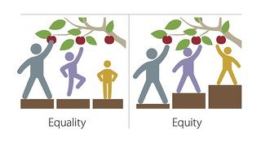
Building a Foundation:
Definitions:
Health –
Determinants of health
Health disparity
Health equity
Notes:
An understanding of terminology provides a strong foundation. In the process of reviewing definitions consider the relationship between culture, language, and health.
Health - Determinants of health, health disparity, health equity
Determinants of Health: Factors that influence health status, including biological factors, like age; behavioral factors, like tobacco use; environmental factors, like housing quality; social factors, like neighborhood segregation; economic factors, like income; and access to healthcare.
Health Disparity: A difference in health outcomes across populations groups. The definition indicates that a difference exists, but it doesn’t consider whether the difference is caused by something preventable.
Health Equity: This exists when all people have the same opportunities and equal access in order to attain their full health potential regardless of the color of their skin, ancestry, ethnicity, level of education, gender identity, sexual orientation, age, religion, socioeconomic status, the job they have, the neighborhood they live in, or their ability status.
Health Inequity: Inequity means lack of fairness or justice and describes differences that result from a lack of access to opportunities and resources. Inequities are avoidable and different than disparities, which are differences that do not imply unfairness.
Discussion Question- What factors in your community influence health?

Slide 36
Building a Foundation:
Definitions:
Socioeconomic considerations –
Poverty & Power
Notes:
An understanding of terminology provides a strong foundation. In the process of reviewing definitions consider the relationship between culture, language, and health.
Socioeconomic considerations – poverty and power
Poverty: Poverty refers to the lack of adequate financial resources such that individuals, households, and entire communities do not have the means to subsist or acquire basic necessities.
Power: The ability to produce intended effects on oneself, on other people, and on things or situations.
Discussion Questions- How is power related to poverty? How does this relationship impact people in our response area?

Slide 37
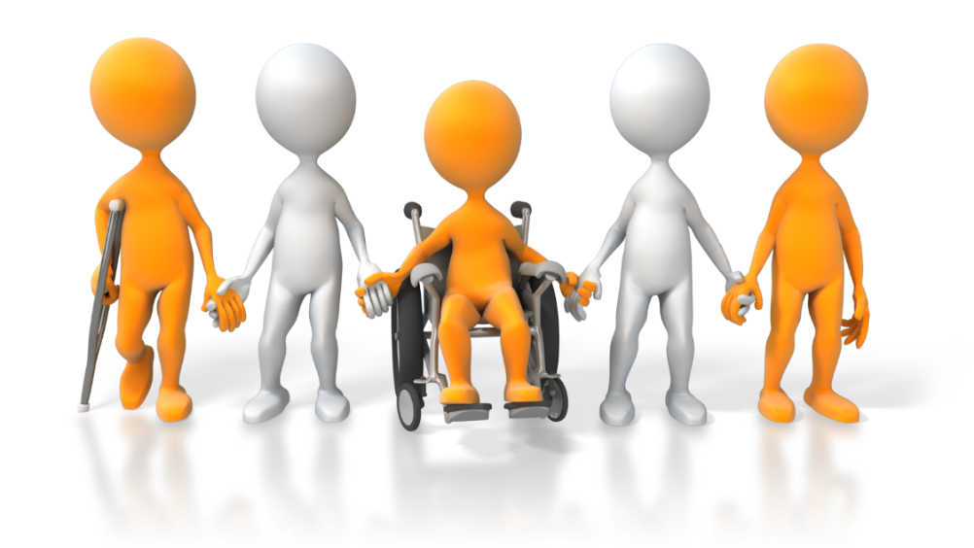
An Overview of Health Disparities:
The Washington State Board of Health (SBOH) provides the following definition of health disparity:
Health disparities describe the disproportionate burden of disease, disability, and death among a particular population or group when compared to the general population.
Notes:
The Washington State Board of Health (SBOH) provides the following definition of health disparity:
Health disparities describe the disproportionate burden of disease, disability, and death among a particular population or group when compared to the general population.
This means there are differences in health outcomes for some groups when compared to outcomes for the greater population.
Discussion Question- How do we help patients overcome these health disparities?

Slide 38
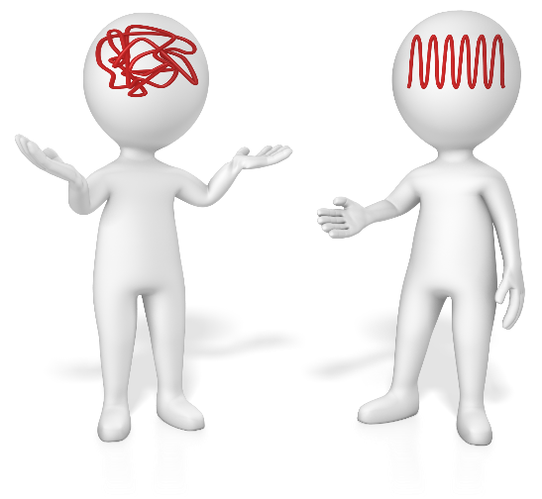
Enhancing Your Communication:
Improving Your Interpersonal Communication
Slow down
Use plain, non-medical language
Show or draw pictures or use Medical Visual Language Translator cards
Limit the amount of information provided and repeat it
Use the teach-back or show-me technique
Create a shame-free environment
Notes:
Improving Your Interpersonal Communication
Slow down.
Use plain, non-medical language.
Show or draw pictures or use Medical Visual Language Translator cards.
Limit the amount of information provided and repeat it.
Use the teach-back or show-me technique.
Create a shame-free environment.
Discussion Question- How can we incorporate these tools into our patient care?

Slide 39
Enhancing Your Communication:
Obtaining information to help with patients and families from culturally diverse backgrounds:
How do we get the information we need?
Do we know if it is proper to ask questions of our patients?
We can start by asking permission
Notes:
Obtaining information to help with patients and families from culturally diverse backgrounds:
The more accurate information we have about others, the more likely we will be able to assist them.
How do we get the information we need? Do we know if it is proper to ask questions of our patients? We can start by asking permission.
Discussion Question- How do we ask permission?
Try to ascertain the value of involving the entire family in the treatment. In many cultures, medical decisions are made by the immediate family or the extended family. If the family can be involved in the decision-making process and the treatment plan, there is a greater likelihood of gaining the patient's compliance with the course of treatment.
Be restrained in relating bad news or explaining in detail complications that may result from a particular course of treatment. "The need to know" is a unique American trait. Watch for and respect signs that the patient has learned as much as he or she is able to deal with.

Slide 40
Enhancing Your Communication:
Questions to help in the process of getting information you need:
So that I might be aware of and respect your cultural beliefs:
Can you tell me what languages are spoken in your home and the languages that you understand and speak?
Can you tell me about your beliefs?
Notes:
Obtaining information to help with patients and families from culturally diverse backgrounds:
Questions to help in the process of getting information you need.
So that I might be aware of and respect your cultural beliefs:
Can you tell me what languages are spoken in your home and the languages that you understand and speak?
Can you tell me about your beliefs and practices including special events such as birth, marriage, and death that you feel I should know?
Discussion Question- How do we make these situations less awkward for ourselves and our patients?

Slide 41
Enhancing Your Communication:
Obtaining information to help with patients and families from culturally diverse backgrounds:
Do you use any traditional health remedies to improve your health?
Is there someone with whom you want us to discuss your medical condition?
Are there certain health care procedures and tests that your culture prohibits?
Notes:
Obtaining information to help with patients and families from culturally diverse backgrounds (Cont.)
Questions to help in the process of getting information you need.
Do you use any traditional health remedies to improve your health?
Is there someone, in addition to yourself, with whom you want us to discuss your medical condition?
Are there certain health care procedures and tests that your culture prohibits?

Slide 42
Enhancing Your Communication:
Questions to help in the process of getting information you need:
Are there any other cultural considerations I should know about to serve your health needs?
Is there anything else you would like me to know?
Do you have any questions for me?
Notes:
Obtaining information to help with patients and families from culturally diverse backgrounds (Cont.)
Questions to help in the process of getting information you need.
Are there any other cultural considerations I should know about to serve your health needs?
Is there anything else you would like me to know?
Is there anything else you would like to know?
Do you have any questions for me? (Encourage two-way communication)

Slide 43
Enhancing Your Communication:
Obtaining information:
The first statement is letting the patient know that you need them to help you. It is a thoughtful way of asking permission.
The purpose of each question is to make communication respectful while establishing trust.
Notes:
Obtaining information to help with patients and families from culturally diverse backgrounds
The first statement you make lets the patient know that you need them to help you. It is a thoughtful way of asking permission.
The purpose of each question is to make communication respectful while establishing trust.

Slide 44
Addressing Language Barriers in Health Care:
System Challenges:
Health care has its own terminology and even if the provider and the patient speak the same language, there are still challenges to effective communication.
The quality of medical care is closely linked to how well providers meet the language needs of the patient.
Notes:
System Challenges:
Health care has its own terminology and even if the provider and the patient speak the same language, there are still challenges to effective communication.
However, the quality of medical care is closely linked to how well providers meet the language needs of the patient.
Discussion Question- Can you think of a time you misunderstood terminology, was it embarrassing?

Slide 45
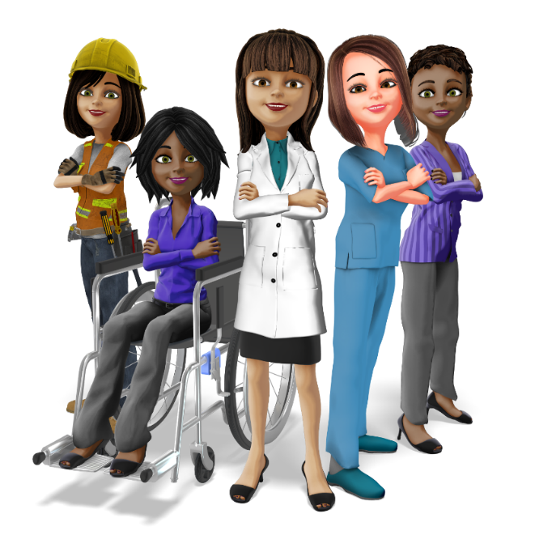
Addressing Language Barriers in Health Care:
System Challenges:
When providers and patients don’t speak the same language, it takes more time and additional resources to ensure they receive the same level of care.
Language barriers are often complicated by cultural differences between the provider and the patient.
Notes:
System Challenges:
When providers only speak English, treating patients who primarily or only speak a language other than English, it takes more time and additional resources to ensure they receive the same level of care as would English speaking patients. In addition, language barriers are often complicated by cultural differences between the provider and the patient.
Discussion Question- What can we do to prepare for these situations and make them less time consuming?

Slide 46
Addressing Language Barriers in Health Care:
System Challenges:
It is vital to ensure you use effective communication and you have supports in place that can overcome these challenges related to language barriers.
Notes:
System Challenges
It is vital to ensure you use effective communication and you have supports in place that can overcome these challenges related to language barriers.
Discussion Question- What supports do we currently have in place? What can we do to be better prepared for these challenges?

Slide 47
Addressing Language Barriers in Health Care:
Patient Challenges:
Lack of awareness of existing services and how to access them.
Inability to communicate adequately with providers within the health care delivery system.
Low patient satisfaction with cross-language encounters may lead to reluctance to return to the health care setting.
Notes:
Patient Challenges:
Patients often encounter the following basic types of problems:
Lack of awareness of existing services and how to access them.
Inability to communicate adequately with providers and ancillary staff at all points within the health care delivery system.
Low patient satisfaction with cross-language encounters may lead to reluctance to return to the health care setting.
Discussion Question- How can we address these barriers in our response area?

Slide 48
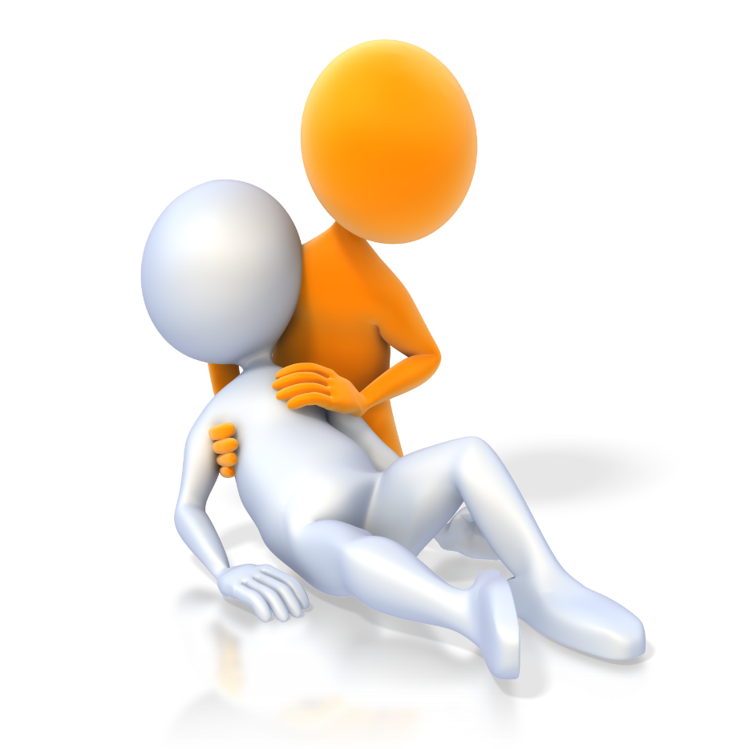
Addressing Language Barriers in Health Care:
Patient Challenges:
Research shows that even when patients who primarily speak a language other than English access health care, health care quality may be diminished, and health outcomes may be poorer for them than for other patients.
Notes:
Patient Challenges
Research shows that even when patients who primarily or only speak a language other than English do access health care, health care quality may be diminished, and health outcomes may be poorer for them than for other patients.
Discussion Question- How can we address this challenge and improve outcomes for our patients?

Slide 49
Addressing Language Barriers in Health Care:
Language barriers often cause health care providers challenges in the following tasks:
In making an accurate diagnosis
In meeting informed consent responsibilities
While explaining care options (This may lead to more limited options for the patient)
In encouraging patients to allow care they may not understand
Notes:
Provider Challenges
Language barriers often cause health care providers challenges in the following tasks:
In making an accurate diagnosis.
In meeting informed consent responsibilities.
While explaining care options. (This may lead to more limited options for caring for the patient.)
In encouraging patients to allow care they may not understand.
Discussion Question- How do we make sure that patients understand the information we are providing them?

Slide 50
Addressing Language Barriers in Health Care:
Linguistic Competency:
Patients who primarily speak a language other than English experience language barriers during every health care encounter.
Gaining access to care, reading forms, and understanding questions and directions present barriers from the outset.
Notes:
Linguistic Competency
Patients who primarily or only speak a language other than English experience language barriers during every health care encounter. Gaining access to care, reading forms, and understanding questions and directions present barriers from the outset. If these encounters are not handled appropriately, patient care is interrupted.
Discussion- How do we break down these barriers for our community members?

Slide 51
Addressing Language Barriers in Health Care:
Resources to support this capacity may include:
Trained medical interpreters
Use of family members
Bilingual/bicultural or multilingual/multicultural staff
Print materials in easy to read, low literacy, picture and symbol formats
Notes:
Linguistic Competency
Resources to support this capacity may include, but is not limited to, the use of:
Trained medical interpreters
Use of family members-
Bilingual/bicultural or multilingual/multicultural staff
Print materials in easy to read, low literacy, picture and symbol formats, i.e. signage such as a Medical Visual Translator card
When using family members things to consider-
Potential for miscommunication of care, if used make sure person who is interpreting is asking the patient the question
Lack of neutrality and confidentiality
May cause embarrassment or strain on family relationship
May be inappropriate to involve minor children
Consider other options such as interpreting services
Discussion Question- How do we access interpreter services and print materials in our area?

Slide 52
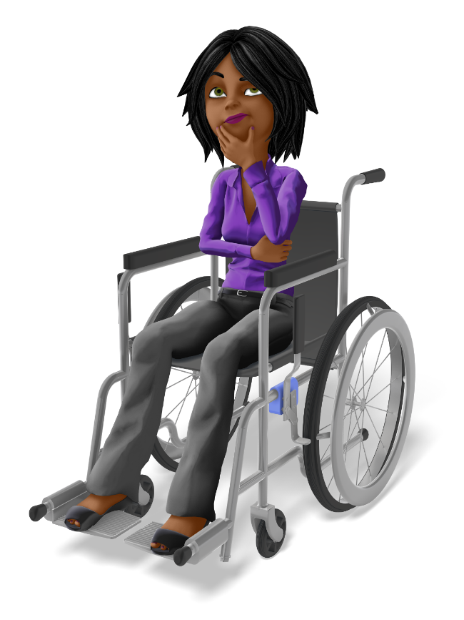
Addressing Language Barriers in Health Care:
People First Language:
People with disabilities are people first.
People with disabilities are no more easily defined by their disability than they are by their gender, age, race, or national origin.
Lack of awareness about disabilities can lead to unintended stereotypes and discrimination.
The way we view and communicate with and about people with disabilities shapes our relationships.
Notes:
People First Language
People with disabilities are people first. People with disabilities are no more easily defined by their disability than they are by their gender, age, race, or national origin.
The way we refer to people with disabilities in our communication is important.
Lack of awareness about disabilities can lead to unintended stereotypes and discrimination.
The way we view and communicate with and about people with disabilities shapes our relationships.

Slide 53
Addressing Language Barriers in Health Care:
People first language puts the emphasis on the person before the disability:
Preferred | Avoid
A person who uses a wheelchair | Wheelchair bound/confined
A person who has a developmental disability | Mentally impaired
A person who is deaf | Hearing impaired
A person with a disability | Handicap, special needs
Notes:
People first language puts the emphasis on the person before the disability.
Discussion Questions- What are other examples of people first language?

Slide 54
Addressing Language Barriers in Health Care:
People First Language
Refer to a person’s disability only if it is relevant.
Avoid terms that lead to exclusion (“special” is associated with “separate” and “segregated” plans and services).
Notes:
People First Language
Refer to a person’s disability only if it is relevant.
Avoid terms that lead to exclusion (e.g., “special” is associated with “separate” and “segregated” plans and services).
Disabilities are often talked about from a medical perspective. The medical perspective frames a disability as a medical issue that needs to be “fixed” . In this perspective, people are seen as lacking or different. This framing blames the way a person’s body functions for them not being able to access spaces, receive services, or participate in public life. This framing is often harmful to people with disabilities and those around them.

Slide 55
Using Interpreters:
Good care means having good communication:
Options-
Onsite or Teleservice professional interpreter
Family Members
Engaging with local community for positive outcomes
Notes:
Good care means having good communication. Trained medical interpreters are the best resource to have available.
Providers need to know the proper way to work with interpreters in the medical encounter.
Options-
Working with family members
Teleservices
Local community needs – how to engage for positive outcomes.
Discussion Questions- What are some considerations when using family members as interpreters?
Using family members, things to consider:
Potential for miscommunication of care
Lack of neutrality and confidentiality
May cause embarrassment or strain on family relationship
May be inappropriate to involve minor children
Consider other options such as interpreting services

Slide 56
Tips on Working Effectively with Interpreters:
12 Tips on Working Effectively with An Interpreter
1. Brief the interpreter
2. Speak directly to the patient
3. Segments
4. Clarifications
Notes:
1. Brief the interpreter – Identify the name of your organization to the interpreter, provide specific instructions of what needs to be done or obtained, and whether you need help with placing a call. The interpreter can assist you in getting the call off to a good start by introducing you and your facility, and then relaying your initial question.
2. Speak directly to the patient – You and the patient can communicate directly with each other as if the interpreter were not there. The interpreter will relay the information and then communicate the patient’s response directly back to you. Also, speak naturally (not louder) and at your normal pace (not slower).
3. Segments – Speak in one sentence or two short ones at a time. Try to avoid breaking up a thought. Your interpreter is trying to understand the meaning of what you're saying, so express the whole thought if possible. Interpreters will ask you to slow down or repeat if necessary. You should pause to make sure you give the interpreter time to deliver your message.
4. Clarifications – If something is unclear, or if the interpreter is given a long statement, the interpreter may ask you for a complete or partial repetition of what was said or clarify what was meant by the statement.

Slide 57
Tips on Working Effectively with Interpreters:
5. Ask if the limited English proficient (LEP) person understands
6. Do not ask for the interpreter’s opinion
7. Everything you say will be interpreted
8. Avoid jargon or technical terms
Notes:
5. Ask if the limited English proficient (LEP) person understands – Please don’t automatically assume that the LEP patient understands you. In some cultures, a person may say “yes” as you explain something, but it doesn’t necessarily mean they understand. It may just mean they want you to keep talking because they are trying to follow the conversation. Also, keep in mind that a lack of English does not necessarily equate to a lack of education.
6. Do not ask for the interpreter’s opinion – Avoid asking the interpreter for opinions or comments. The interpreter’s job is to convey the meaning of the source language and not allow personal opinion to tinge the interpretation (see the Language Line Services “Code of Ethics”).
7. Everything you say will be interpreted – Try to avoid private conversations with your colleagues. Whatever the interpreter hears will be interpreted.
8. Avoid jargon or technical terms – To help your patient and interpreter better understand you, don’t use industry jargon, slang, idioms, acronyms, or technical terms. Clarify vocabulary that is unique to the situation and provide examples if needed to explain a term.

Slide 58
Tips on Working Effectively with Interpreters:
9. Length of interpretation session
10. Reading scripts
11. Culture
12. Closing of the call
Notes:
9. Length of interpretation session – Many concepts you express may have no equivalent in other languages. The interpreter may have to describe or paraphrase the terms you use. As a result, an interpretation might take twice as long as a conversation carried on in English only. Please avoid interrupting the interpreter while he or she is interpreting.
10. Reading scripts – Though we may not notice it, we often talk more quickly when reading a script. When reading a script, prepared text, or a disclosure, please slow down to give the interpreter a chance to keep up with your pace.
11. Culture – Professional interpreters are familiar with the culture, and customs of the limited English proficient speaker. During the interpretation session, the interpreter might identify and point out a cultural issue of which you may not be aware of. Also, if the interpreter feels that a particular question is culturally inappropriate, he or she may ask you to rephrase it.
12. Closing of the call – The interpreter will wait for you to initiate the closing of the call. When appropriate, the interpreter will offer further assistance and will be the last to disconnect from the call.

Slide 59
System & Organization Improvement:
Institutions are designed to give a consistent level of service for the greatest number of people in the most cost-efficient manner.
Many find that providing culturally and linguistically appropriate services not only improves patient care but can also improve efficiency.
Notes:
Institutions are designed to give a consistent level of service for the greatest number of people in the most cost-efficient manner.
Many find that providing culturally and linguistically appropriate services not only improves patient care but can also improve efficiency.
Discussion Question- How can we improve efficiency while providing culturally appropriate services in our area?

Slide 60
System & Organization Improvement:
Systems that successfully provide culturally, and linguistically competent services tend to:
Define culture broadly
Value clients’ cultural beliefs
Recognize complexity in language interpretation
Facilitate learning between providers and communities
Involve the community in defining and addressing service needs
Collaborate with other agencies
Recognize training in cultural competence and medical interpretation as equally important as training in other essential clinical skills
Institutionalize cultural and linguistic competence
Notes:
According to the Health Resources and Services Administration (HRSA) systems that successfully provide culturally, and linguistically competent services tend to:
Define culture broadly
Value clients’ cultural beliefs
Recognize complexity in language interpretation
Facilitate learning between providers and communities
Involve the community in defining and addressing service needs
Collaborate with other agencies
Recognize training in cultural competence and medical interpretation as equally important as training in other essential clinical skills
Institutionalize cultural and linguistic competence
Discussion Question- How do we incorporate these concepts into our training program?

Slide 61
System & Organization Improvement:
Engaging the community in their health care will help us create solutions to meet the challenges we face in providing culturally and linguistically appropriate care.
Notes:
Engaging the community in their health care will help us create solutions to meet the challenges we face in providing culturally and linguistically appropriate care.
Discussion Question- How do we engage the community in their healthcare within our area?

Slide 62
Tools to Help Provide Culturally & Linguistically Appropriate Services:
Six Steps to Community Engagement
Go into the community and establish relationships, build trust, work with formal and informal leadership, and seek commitment from community organizations and leaders to create processes for mobilizing the community.
Remember and accept that community self-determination is the responsibility and right of all people who comprise a community.
All aspects of community engagement must recognize and respect community diversity. Awareness of the various cultures of a community and other factors of diversity must be paramount in designing and implementing community engagement approaches.
Notes:
These are six generalized steps to engage communities. These steps can be adapted to fit the culture and demographics of your response area.
Six Steps to Community Engagement
Go into the community and establish relationships, build trust, work with formal and informal leadership, and seek commitment from community organizations and leaders to create processes for mobilizing the community.
Remember and accept that community self-determination is the responsibility and right of all people who comprise a community.
All aspects of community engagement must recognize and respect community diversity. Awareness of the various cultures of a community and other factors of diversity must be paramount in designing and implementing community engagement approaches.

Slide 63
Tools to Help Provide Culturally & Linguistically Appropriate Services:
Six Steps to Community Engagement
4. Community engagement can only be sustained by identifying and mobilizing community assets, and by developing capacities and resources for community health decisions and action.
5. An engaging organization or individual change agent must be prepared to release control of actions or interventions to the community and be flexible enough to meet the changing needs of the community.
6. Community collaboration requires long-term commitment by the engaging organization and its partners.
Notes:
Six Steps to Community Engagement
4. Community engagement can only be sustained by identifying and mobilizing community assets, and by developing capacities and resources for community health decisions and action.
5. An engaging organization or individual change agent must be prepared to release control of actions or interventions to the community and be flexible enough to meet the changing needs of the community.
6. Community collaboration requires long-term commitment by the engaging organization and its partners.
Discussion Question- How can we utilize these steps in our community?

Slide 64
System & Organization Improvement:
Culturally and Linguistically Appropriate Services (CLAS):
The CLAS standards present an approach that includes:
Promoting culturally and linguistically appropriate services in policy and practices, recruitment and leadership, and workforce development.
Offering language assistance and providing easy to understand materials in languages commonly used in the area.
Assessing the organization's culturally and linguistically appropriate services through data collection and evaluation.
Notes:
Culturally and Linguistically Appropriate Services (CLAS): The CLAS standards offer approaches to Governance, Leadership, and Workforce; Communication and Language Assistance; and Engagement, Continuous Improvement and Accountability
The CLAS standards present an approach that includes:
Promoting culturally and linguistically appropriate services in policy and practices, recruitment and leadership, and workforce development.
Offering language assistance and providing easy to understand materials in languages commonly used in the area.
Assessing the organization's culturally and linguistically appropriate services through data collection and evaluation.

Slide 65
System & Organization Improvement:
Provider Actions – Reducing disparities in health care and outcomes is a national and state priority:
Cultural competency awareness through training in medical education programs
Data collection and research methodologies among underserved communities
The number and availability of culturally diverse health care providers and administrators
Notes:
Provider Actions – Reducing disparities in health care and outcomes is a national and state priority.
Various efforts are underway to improve:
Cultural competency awareness through training in medical education programs
Data collection and research methodologies among underserved communities
The number and availability of culturally diverse health care providers and administrators.

Slide 66
System & Organization Improvement:
Individuals involved at all levels of health care can take steps to improve the quality of care provided to culturally diverse patients:
Patient-centered, individualized care is crucial to effective treatment
Asking the right questions can help facilitate the process
Notes:
Provider Actions – Reducing disparities in health care and outcomes is a national and state priority.
Individuals involved at all levels of health care can take steps to improve the quality of care provided to culturally diverse patients.
Patient-centered, individualized care is crucial to effective treatment
Asking the right questions can help facilitate the process.
Discussion question- What are the right questions to ask the people we serve?

Slide 67
System & Organization Improvement:
Patients who see positive characteristics in their providers are more likely to seek treatment and follow medical advice:
Patients with higher levels of trust are more satisfied with the patient- provider relationship.
This higher level of trust fosters:
Increased patient participation in their care
Improved health outcomes
Improved patient safety
Notes:
Provider Actions – Reducing disparities in health care and outcomes is a national and state priority.
Patients who see positive characteristics in their providers (such as being thorough, understanding, responsive and respectful) are more likely to seek treatment and follow medical advice.
Patients with higher levels of trust are more satisfied with the patient- provider relationship.
This higher level of trust fosters:
Increased patient participation in their care
Reduced appointment cancellations and no-shows
Improved health outcomes
Improved patient safety

Slide 68
Data Sources:
Washington State data reveal that there are differences in health outcomes for racial, ethnic, and cultural groups.
Notes:
Population data presented by race and ethnicity has contributed to making health disparities a priority in our state and the nation. Washington State data reveal that there are differences in health outcomes for racial, ethnic, and cultural groups when compared to white people.

Slide 69
Data Sources to Explore Health Disparities in Washington:
The Washington State Department of Health (DOH) collects and uses health-related data to measure the quality and accessibility of healthcare in the state. Current data can be found in several locations. Reviewing these sites provides an opportunity to access current and relevant data specific to your local area.
Notes:
The Washington State Department of Health (DOH) collects and uses health-related data to measure the quality and accessibility of healthcare in the state. Current data can be found in several locations. Reviewing these data sites provides an opportunity to access current and relevant data specific to your local area. The following slides will show you how to access this information.

Slide 70
Washington Tracking Network (WTN) | Washington State Department of Health WTN is a public facing data and dashboard portal intended to aid a variety of audiences in program planning, evaluation, surveillance, and many other public health efforts. Tools are supported by the Environmental Health Division and managed by individual programs overseeing the data topic areas specific to each dashboard.
Data Sources to Explore Health Disparities in Washington:
Notes:
Washington Tracking Network (WTN) | Washington State Department of Health WTN is a public facing data and dashboard portal intended to aid a variety of audiences in program planning, evaluation, surveillance, and many other public health efforts. Tools are supported by the Environmental Health Division and managed by individual programs overseeing the data topic areas specific to each dashboard.

Slide 71
Washington Tracking Network (WTN) | Washington State Department of Health Dashboards: Data dashboards provide an interactive way to explore public health and environmental data. Most dashboards have filters for easily selecting the measure, geography, and timeframe of interest. Data can be viewed as a map or as trends over time and are available for download.
Data Sources to Explore Health Disparities in Washington:
Notes:
Washington Tracking Network (WTN) | Washington State Department of Health Dashboards: Data dashboards provide an interactive way to explore public health and environmental data. Most dashboards have filters for easily selecting the measure, geography, and timeframe of interest. Data can be viewed as a map or as trends over time and are available for download.

Slide 72
Data Sources to Explore Health Disparities in Washington:
Washington Tracking Network (WTN) | Washington State Department of Health The IBL mapping tool - lets you explore and compare your community with those around you. It displays information for a variety of topics by presenting a community’s rank between 1 (lowest) and 10 (highest).
Notes:
Each rank represents about 10% of the communities. For example, if your community is ranked 7 for health disparities, it means that 60% of the communities in Washington State have a lower level of health disparity and 30% have a greater level of disparity.
Discussion Question- How is your community ranked for health disparities?

Slide 73
Data Sources to Explore Health Disparities in Washington:
The Washington Tracking Network’s (WTN) Community Report tool allows you to see a variety of health measures for a given geography. You can select which county(s) you would like data for, and which data you would like to see. Data can be viewed as a map or as trends over time and are available for download.
Washington Tracking Network (WTN) | Washington State Department of Health
mobile app: WTN On The Go
Notes:
The Washington Tracking Network’s (WTN) Community Report tool allows you to see a variety of health measures for a given geography. You can select which county(s) you would like data for, and which data you would like to see. Data can be viewed as a map or as trends over time and are available for download.
Washington Tracking Network (WTN) | Washington State Department of Health mobile app: WTN On The Go

Slide 74
Summary & Review:
Personal culture is active and ever changing.
Cultural competence begins with the individual. It includes respect, awareness, and acceptance of differences in worldviews.
Don’t make assumptions about people and situations; look for accurate information from the patient or family or community member.
Notes:
Personal culture is active and is ever changing.
Cultural competence begins with the individual. It includes respect, awareness, and acceptance of differences in worldviews.
It is also important not to make assumptions about people and situations, but to look for accurate information from the patient or family or community member.

Slide 75
Summary & Review:
Language and culture influence how we approach health and provide care.
The CLAS Standards are an excellent road map to providing culturally & linguistically appropriate services.
Notes:
Language and culture influence how we approach health and provide care.
Successful health care systems work to put in place tools and processes that will benefit all patients.
The CLAS Standards developed by the Office of Minority Health are an excellent road map to providing culturally and linguistically appropriate services.

Slide 76
Summary & Review:
Providers, patients, and community members bring their unique cultural backgrounds and expectations to the medical encounter.
Cultural competence becomes a part of the process when information is successfully shared.
Notes:
Providers, patients, and community members bring their unique cultural backgrounds and expectations to the medical encounter. Cultural competence becomes a part of the process when information is successfully shared. This means that 3 different entities must interact in a seamless manner: patients, providers, and systems.

Slide 77
Summary & Review:
Using trained medical interpreters reduces risk.
Providers also need to know how to work effectively with interpreters.
Notes:
Using trained medical interpreters reduces risk. Providers also need to know how to work effectively with interpreters.
Discussion Question- Do you recall the types of risk using trained medical interpreters reduces?

Slide 78
Summary & Review:
Effective communication between patients and providers is necessary for delivery of quality care.
Providers and organizations must have systems, policy, and processes in place to meet the challenges of patients who primarily speak a language other than English or who have low literacy.
Notes:
There must be effective communication between patients and providers for quality care to result. Providers and organizations must have systems, policy, and processes in place to meet the challenges of patients who primarily or only speak a language other than English or who have low literacy.

Slide 79
Next Steps:
Reflect on and review the needs of your community.
How do you improve patient outcomes for every community member?
Notes:
Discussion- How will you use the information presented today?
*Add closing thoughts on mindset here*

Slide 80
References:
Agency for Healthcare Research and Quality (US). (2021). Disparities in Healthcare 2021 National Healthcare Quality and Disparities Report. Rockville (MD): NIH. Retrieved 2023, from https://www.ncbi.nlm.nih.gov/books/NBK578532/
Alvord , L., & Cohen van Pelt, E. (1999). The Scalpel and the Silver Bear. New York: Bantam.
American Public Health Association (APHA). (2023). Health Equity. Retrieved from https://www.apha.org/topics-and-issues/health-equity
Centers for Disease Control and Prevention. (2023). Health Equity. Retrieved from CDC.GOV: https://www.cdc.gov/healthequity/index.html
Creamer, J., Scrider, E. A., Burns, K., & Chen, F. (2022). Poverty in the United States: 2021. U.S. Department of Commerce. Retrieved from https://www.census.gov/content/dam/Census/library/publications/2022/demo/p60-277.pdf
CTSA Community Engagement Key Function Committee Task Force. (2011). Principles of Community Engagement - Second Edition. NIH Publication. Retrieved from https://www.atsdr.cdc.gov/communityengagement/pdf/PCE_Report_508_FINAL.pdf
Davis, U. (2023, 12). LGBTQIA Resource Center Glossary. Retrieved from LGBTQIA Resource Center: https://lgbtqia.ucdavis.edu/educated/glossary
Gardenswartz, L., & Rowe, A. (2010). TABLE 5.1 | Comparing Cultural Norms and Values. In Managing Diversity: A complete Desk Reference & Planning Guide.
Hewes HA, D. M. (2018, Mar-Apr). Prehospital Pain Management: Disparity By Age and Race. Prehosp Emerg Care, 189-197. Retrieved from https://pubmed.ncbi.nlm.nih.gov/28956669/
Hoffman, K. M., Trawalter, S., Axt, J. R., & Oliver, M. N. (2016, April 4). Racial bias in pain assessment and treatment recommendations, and false beliefs about biological differences between blacks and whites. The Proceedings of the National Academy of Sciences (PNAS), 4296-4301. Retrieved 2023, from https://www.pnas.org/doi/full/10.1073/pnas.1516047113
Human Rights Campaign. (2024, 1). Glossary of Terms. Retrieved from Human Rights Campaign: https://www.hrc.org/resources/glossary-of-terms?utm_source=GS&utm_medium=AD&utm_campaign=BPI-HRC-Grant&utm_content=276004739490&utm_term=gender%20identity&gclid=EAIaIQobChMI54LJmcbg3AIVy2p-Ch0ZtwLrEAAYASAAEgJlRfD_BwE

Slide 81
References:
Institute of Medicine (US) Committee on Understanding and Eliminating Racial and Ethnic Disparities in Health Care. (2003). Unequal Treatment: Confronting Racial and Ethnic Disparities in Health Care. (A. Y. Brian D. Smedley, Ed.) National Academies Press (US).
Janice A. Sabin, P. M. (2022). Tackling Implicit Bias in Health Care. The New England Journal of Medicine , 387:105-107.
JW, S. S. (1995). When Two Cultures Meet: American Medicine and the Cultures of Diverse Patient Populations, Book 1, What Language Does Your Patient Hurt In? An 8-Part Series of Practical Guides to the Care and Treatment of Patients from Other Cultures. Amberst, MA: Amherst Educational Publishing.
Kennel, J. (2018, May 31). Investigating EMS Treatment Disparities by Patient Race/Ethnicity for Traumatic and Painful Emergencies. Retrieved from Oregon Health & Science University: https://www.ohsu.edu/sites/default/files/2018-08/EMS-Treatment-Disparities.pdf
Language Line Services, Inc. (2005). 12 Tips on Working Effectively With An Interpreter. Retrieved from https://www.srln.org/system/files/attachments/12%20Tips%20On%20Working%20Effectively%20With%20An%20Interpreter%20%282005%29.pdf
Merriam-Webster. (2023). Retrieved from https://www.merriam-webster.com/
National Institute of Health. (2023). Retrieved from Implicit Bias: https://diversity.nih.gov/sociocultural-factors/implicit-bias
National Standards for Culturally and Linguistically Appropriate Services (CLAS) in Health and Health Care. (2023). Retrieved from U.S. Department of Health and Human Services: https://thinkculturalhealth.hhs.gov/assets/pdfs/EnhancedNationalCLASStandards.pdf
Office of Minority Health, Office of the Secretary, Department of Health and Human Services. (2013, 9 24). National Standards for Culturally and Linguistically Appropriate Services (CLAS) in Health and Health Care. Retrieved from https://www.federalregister.gov/documents/2013/09/24/2013-23164/national-standards-for-culturally-and-linguistically-appropriate-services-clas-in-health-and -health#:~:text=The%20final%20enhanced%20National%20Standards%20for%20Culturally%20and,Care%20will%
Oxford Learner's Dictionaries. (2023). Retrieved from https://www.oxfordlearnersdictionaries.com/us/

Slide 82
References:
Professional Development. (n.d.). Retrieved 2023, from National Ambulance LGBT+ Network: https://www.ambulancelgbt.org/resources/professional-development/
Washington State Department of Health. (2023). Common Definitions. Retrieved from https://doh.wa.gov/sites/default/files/legacy/Documents/1000/CommonDefinitions_Equity.pdf?uid=648a10f45831f
Washington State Department of Health. (2023). Health Equity. Retrieved from https://doh.wa.gov/community-and-environment/health-equity
Washington Tracking Network, (WTN). (2023). Public Health Data . Retrieved from https://fortress.wa.gov/doh/wtn/WTNIBL/
World Health Organization. (2023). Social determinants of health. Retrieved from https://www.who.int/health-topics/social-determinants-of-health#tab=tab_1
Sex, Gender, and Sexuality | National Institutes of Health (NIH)

Slide 83
To request this document in another format, call 1-800-525-0127. Deaf or hard of
hearing customers, please call 711 (Washington Relay) or email civil.rights@doh.wa.gov.

